Slide 1
PROFIT PREDICTION MODEL DATA SCIENCE
SUBMITTED BY
DEEPAK KUMAR
National institute of technology Sikkim
Under the guidance of exposys
data labs

Slide 2
CONTENS
INTRODUCTION TO MODEL
LIBRARY IMPORTING
DATA CLEANING
Data Visualization
Feature exploration
Model development
Model evaluation

Slide 3
Introduction to project
In this project , we will be predicting the profit from the startup’s dataset with the features available to us. We’re using the 50-startups dataset for this problem statement and we will be using the concept of Multiple linear regression to predict the profit of startups companies
his particular dataset holds data from 50 startups The features in this dataset are R&D spending, Administration Spending, Marketing Spending, and location features, while the target variable is: Profit.
. R&D spending: The amount which startups are spending on Research and development.
. Administration spending: The amount which startups are spending on the Admin panel.
. Marketing spending: The amount which startups are spending on marketing strategies. . Profit: How much profit that particular startup is mak

Slide 4
Importing libraries
import numpy as np # for performing mathematical calculations behind ML algorithm import matplotlib.pyplot as plt # for visualization
import pandas as pd # for handling and cleaning the dataset
import seaborn as sns # for visualization
import sklearn # for model evaluation and development
dataset = pd.read_csv('50_Startups.csv’)
These all operations performed on vs code

Slide 5
Analyzing the data
dataset.head()

Slide 6
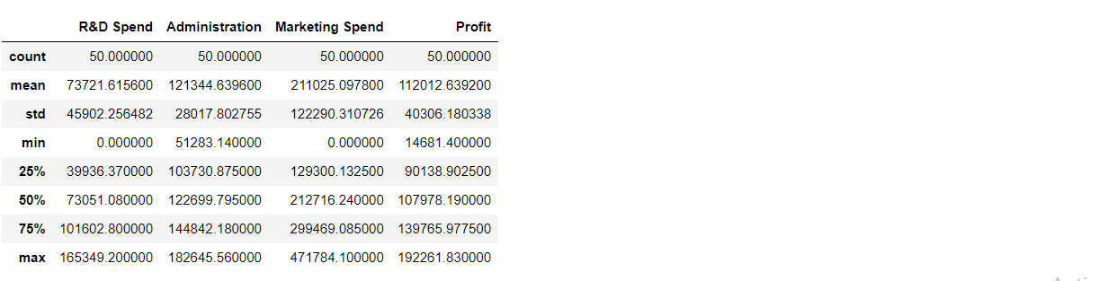
Numerical/Statistical analysis of the dataset
code
dataset.describe()

Slide 7
Outliers detection in the target variable
utliers = ['Profit’]
plt.rcParams['figure.figsize'] = [8,8]
sns.boxplot(data=dataset[outliers], orient="v“
palette="Set2" , width=0.7) # orient = "v" :
vertical boxplot ,
# orient = "h" :
hotrizontal boxplot plt.title("Outliers Variable Distribution")
plt.ylabel("Profit Range")
plt.xlabel("Continuous Variable") plt.show()

Slide 8
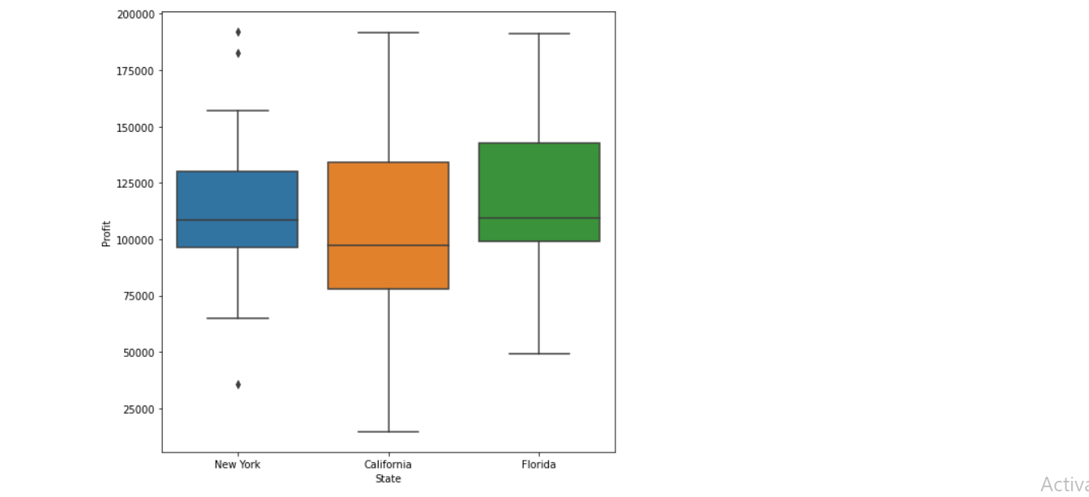
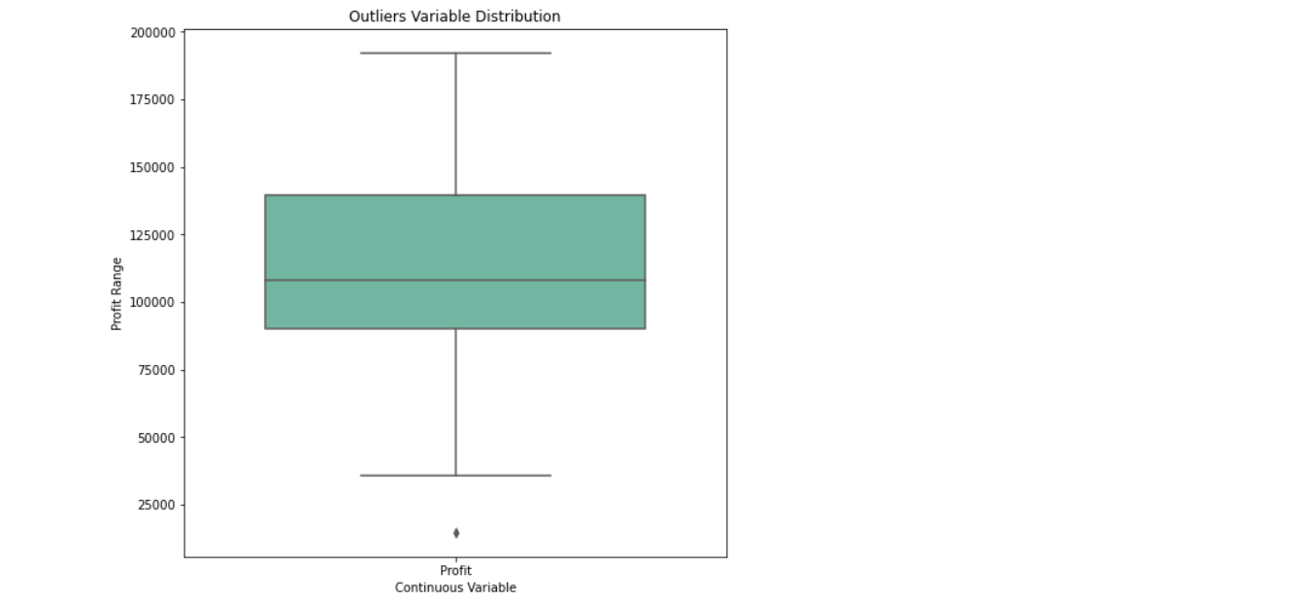
OUTPUT While looking at the boxplot we can see the outliers in the profit(target variable), but the amount of data is not much (just 50 entries) so it won’t create much negative Impact

Slide 9
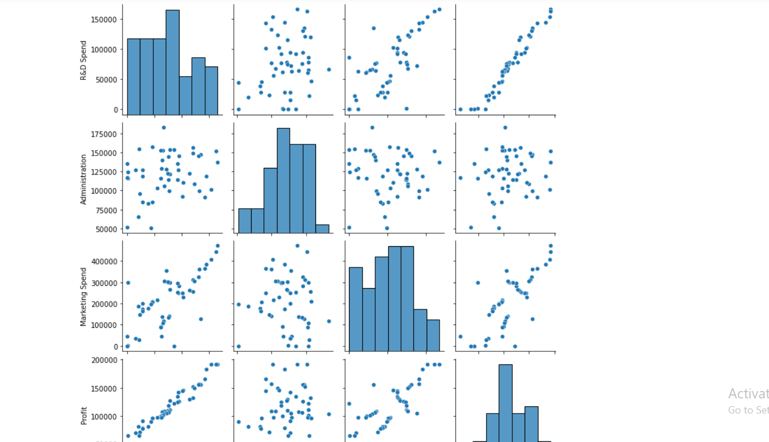
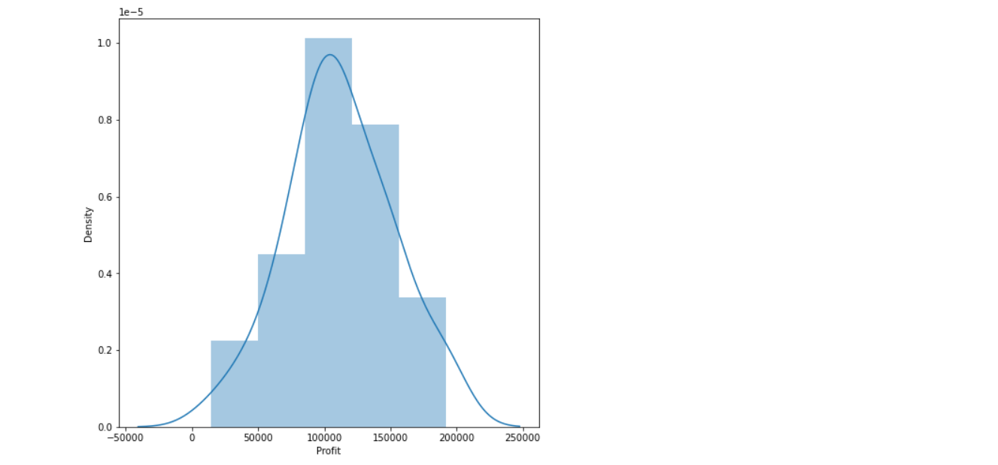
Histogram on Profit sns.distplot(dataset['Profit'],bins=5,kde=True) plt.show(

Slide 10
Model Development
# spliting Dataset in Dependent & Independent Variables
X = dataset.iloc[:, :-1].values
y = dataset.iloc[:, 4].values
labelencoder = LabelEncoder()
X[:, 3] = labelencoder.fit_transform(X[:, 3])
X1 = pd.DataFrame(X) X1.head()

Slide 11
split the data into training and testing data
from sklearn.model_selection import train_test_split
x_train,x_test,y_train,y_test = train_test_split(X,y,train_size=0.7,random_state=0) x_train
train Output: array([[130298.13, 145530.06, 323876.68, 1], [119943.24, 156547.42, 256512.92, 1], [1000.23, 124153.04, 1903.93, 2], [542.05, 51743.15, 0.0, 2], [65605.48, 153032.06, 107138.38, 2], [114523.61, 122616.84, 261776.23, 2], [61994.48, 115641.28, 91131.24, 1], [63408.86, 129219.61, 46085.25, 0], [78013.11, 121597.55, 264346.06, 0], [23640.93, 96189.63, 148001.11, 0], [76253.86, 113867.3, 298664.47, 0], [15505.73, 127382.3, 35534.17, 2], [120542.52, 148718.95, 311613.29, 2], [91992.39, 135495.07, 252664.93, 0], [64664.71, 139553.16, 137962.62, 0], [131876.9, 99814.71, 362861.36, 2], [94657.16, 145077.58, 282574.31, 2], [28754.33, 118546.05, 172795.67, 0], [0.0, 116983.8, 45173.06, 0], [162597.7, 151377.59, 443898.53, 0], [93863.75, 127320.38, 249839.44, 1], [44069.95, 51283.14, 197029.42, 0], [77044.01, 99281.34, 140574.81, 2], [134615.46, 147198.87, 127716.82, 0], [67532.53, 105751.03, 304768.73, 1], [28663.76, 127056.21, 201126.82, 1], [78389.47, 153773.43, 299737.29, 2], [86419.7, 153514.11, 0.0, 2], [123334.88, 108679.17, 304981.62, 0], [38558.51, 82982.09, 174999.3, 0], [1315.46, 115816.21, 297114.46, 1], [144372.41, 118671.85, 383199.62, 2], [165349.2, 136897.8, 471784.1, 2], [0.0, 135426.92, 0.0, 0], [22177.74, 154806.14, 28334.72, 0]], dtype=object

Slide 12
Testing the model using the predict function
y_pred = model.predict(x_test) y_pred
Testing scores testing_data_model_score = model.score(x_test, y_test) print("Model Score/Performance on Testing data",testing_data_model_score) training_data_model_score = model.score(x_train, y_train) print("Model Score/Performance on Training data",training_data_model_score)
Output: Model Score/Performance on Testing data 0.9355139722149948 Model Score/Performance on Training data 0.9515496105627431

Slide 13
Model evaluation
Model evaluation 1. R2 score: R2 score – R squared score.
It is one of the statistical approaches by which we can find the variance or the spread of the target and feature data.
from sklearn.metrics import r2_score r2Score = r2_score(y_pred, y_test) print("R2 score of model is :" ,r2Score*100)
Output: R2 score of model is: 93.39448007716636
MSE: MSE – Mean Squared Error. By using this approach we can find that how much the regression best fit line is close to all the residual. from sklearn.metrics import mea

Slide 14
Validation
Root Mean Squared Error is: 788954.7666974603
MAE: MAE – Mean Absolute Error. By using this approach we can find the difference between the actual values and predicted values but that difference is absolute i.e. the difference is positive.
from sklearn.metrics import mean_absolute_error mae = mean_absolute_error(y_pred,y_test) print("Mean Absolute Error is :" ,mae)
Output: Mean Absolute Error is: 6503.577323580025 Conclusion So, the mean absolute error is 6503.577323580025. Therefore our predicted value can be 6503.577323580025 units more or less than the actual value.

Slide 15
Conclusions and result
predicted value is close to the actual values i.e the one present in the testing set, Hence we can use this model for prediction.
The marketing spend seems to be directly proportional (though a little bit outliers are there) with the profit
. Therefore our predicted value can be 6503.577323580025
his machine learning model will be quite helpful in such a situation where we need to find a profit , based on the amount which we spend from the 50 startups dataset

